Slide 1
INTERNSHIP
PRESENTATION
Madeline King
Supervisor: Agnes Grudniewicz
March 30, 2020
MSc in Health Systems

Slide 2
AGENDA
THE ORGANIZATION
EXAMPLE PROJECT
THEIR WORK
OTHER OPPORTUNITIES
RAPID REVIEW METHODOLOGY
THANK YOU

Slide 3
THE ORGANIZATION
ABOUT
“The North American Observatory on Health Systems and Policies (NAO) is a collaborative partnership of interested researchers, research organizations, governments, and health organizations promoting evidence-informed health system policy decision-making.” -NAO Website
MY
ROLE
I worked as a student research intern under the supervision of Allie Peckham. In this role I worked on a number of projects throughout my 4-month term.

Slide 4
THEIR WORK
WHAT THEY OFFER
Comparative health systems and policy studies
Policy briefs and environmental scans
Health System profiles
Policy news and updates
OBJECTIVES
The NAO aims to establish a health systems research network in North America to collect, analyze and disseminate research on health care policies and reforms. They aim to create rapid responses for governments to obtain environmental scans or analyses of policies.

Slide 5
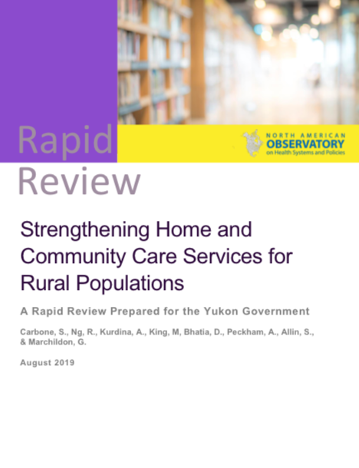
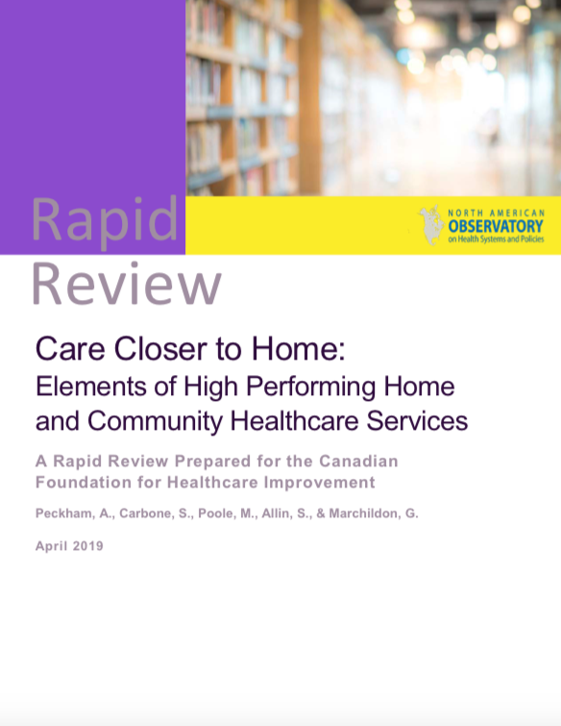
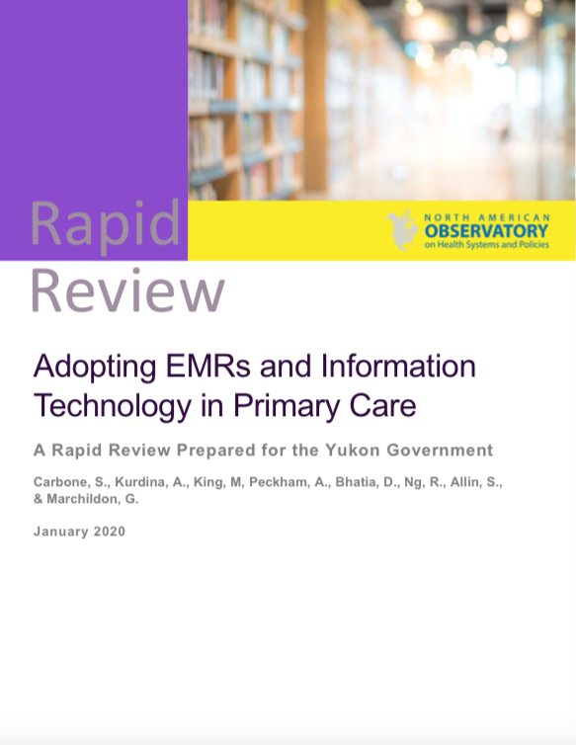
RAPID REVIEW METHODOLOGY
Rapid reviews are environmental scans or quick literature reviews on policy issues.
Notes:
Rapid reviews are environmental scans or quick literature reviews on policy issues identified as urgent or emerging by NAO members.

Slide 6
EXAMPLE PROJECT
This rapid review seeks to understand the outcomes associated with EMR use, the barriers towards implementation, and strategies for encouraging adoption.
Rapid Scoping Review
Rapid Jurisdictional Review
To identify relevant review articles in three health sciences databases
To briefly review three jurisdictions of interest including Sweden, the United States, and Australia to identify existing EMR initiatives in primary care
Notes:
Given that EMRs and related information technologies are a largecomponentof high-performing healthcare systems and there remains very little progress towards territorial, provincial, or national EMR systems, this rapid review seeks to understand the outcomes associated with EMR use, the barriers towards implementation, and strategies for encouraging adoption.
The literature scoping review was supplemented with brief reviews of three jurisdictions of interest –
namely, Sweden, the United States (Intermountain Health Care System), and Australia – to identify
existing EMR initiatives in primary care, as well as best practices and impacts, if available.

Slide 7
EXAMPLE PROJECT CONT’D
RESULTS
STRATEGIES TO IMPROVE EMR UPTAKE
Evidence to suggest that the adoption of EMRs was associated with a range of positive health, process, and system outcomes
Engage organizations and end users
Fully integrate EMRs
Utilize stakeholder feedback on design features
Provide ongoing training and support
Consider utilizing financial support or incentives
Conduct meaningful evaluations
Identified barriers toward EMR adoption included utility and user-friendliness
Notes:
Engage organizations and end users in the planning, development, and implementation of EMR technologies to ensure that the tool will properly address their needs.
Fully integrate EMRs into the practices of providers and to services across organizations, in order to reduce unnecessary administrative burden and maximize the utility of the tool.
Utilize stakeholder feedback on design features and add-ons that will encourage their use of the technology.
Rapid Review No. 18
Provide ongoing training and support to ensure that end-users are comfortable with the tool and have resources in place to respond to inquiries.
Consider utilizing financial support or incentives to encourage providers and organizations to invest in the technology.
Conduct meaningful evaluations of the EMR tool and its use, to better understand adoption patterns, associated outcomes, and the strengths and limitations of the tool.

Slide 8
OTHER OPPORTUNITIES
COMPARTIVE STUDY
WEBINAR
Policy programs for people living with dementia
Priority Health Challenges Webinar
Joined research team for comparative study on five North American jurisdictions
Represented the NAO by presenting on NAO research on Care Closer to Home
RESEARCH ASSISTANT
Hired to continue to work with the NAO part-time
Notes:
This work is part of a broader comparative study of policy programs for people living with dementia and co-existing complex health needs in five North American jurisdictions. The five jurisdictions included in the broader study are: British Columbia (BC), Ontario (ON), Newfoundland and Labrador (NL), Vermont (VT) and New York State (NY). The purpose of the broader study is to examine and assess key feature of policy programs in five North American jurisdictions that address the health and social needs of people living with dementia and co-existing complex conditions and their unpaid caregivers. There are two phases of data collection—a quantitative phase (in progress) and a qualitative phase (the subject of this report).

Slide 9
THANK YOU

